Slide 1

UNIVERSITY INSTITUTE OF ENGINEERING
DEPARTMENT OF ACADEMIC UNIT-1
Bachelor of Engineering (CSE)
SUBJECT NAME: Basics Electrical & Electronics Engineering
SUBJECT CODE : 21ELH-101
By
AKHIL NIGAM
INTRODUCTION TO TRANSFORMER
Lecture No. 8
DISCOVER . LEARN . EMPOWER

Slide 2
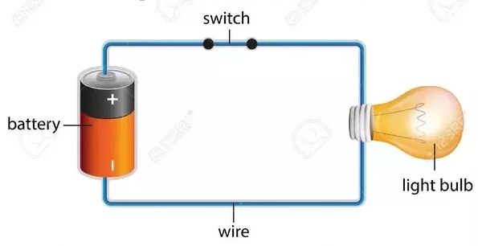
Lecture Objectives
S. No. | Objectives
1 | To make student aware about faraday’s law of electromagnetic induction
2 | To aware about introduction to transformer and its working principle
3 | To provide knowledge about different types of transformer
4 | To aware about construction of core type and shell type transformer
5 | To give knowledge about transformatio ratio of gtransformer
https://www.quora.com/What-are-the-differences-between-a-circuit-and-an-electric-circuit

Slide 3
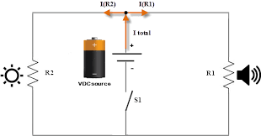
Course Objectives
S. No. | Objectives
1 | To meet students with basic knowledge of dc circuits, electromagnetism and ac fundamentals.
2 | To aware about introduction to single and three phase ac circuit with their construction and working principles.
3 | To provide knowledge about electrical and electronics engineering fundamentals.
4 | To acquire specific knowledge skills so as to comprehend how electric, magnetic and electronic circuits are applied in practice.
https://library.automationdirect.com/basic-electrical-theory/

Slide 4
Course Outcomes
CO Number | Title | Level
CO1 | Identify the different types of electrical elements and the basic op-amp circuit elements and to illustrate the various types of motors, transducers and batteries. | Remember
CO2 | Understand basic principles of transformers, transducers, op-amps, DC and AC motors and to compare the different methods for analyzing electrical and magnetic circuits. | Understand
CO3 | Derive the relationships between parameters in electric and magnetic circuits and motors and to determine specifications of op-amps. | Analyze
CO4 | Solve the basic problems related to electric circuits, magnetic circuits and motors and to assess the characteristics of different configurations of op-amps. | Evaluate
CO5 | Design the different applications of transducers, motors as well as the op-amps like adders, subtractor and comparators. | Create
https://library.automationdirect.com/basic-electrical-theory/

Slide 5
Importance of Basic Electrical & Electronics Engineering
Use from home appliances to industrial plants.
Usage in communication and satellite navigation system.
Handles in electronics equipment and computers.
Deals with the problem of power transmission and motor control.
Control and monitor the medical appliances in hospitals.
High voltage applications with heavy current.
Robotics applications.
Product designing and development.

Slide 6
Contents
Faraday’s Law of Electromagnetic Induction
Types of induced emf
Self induced emf
Mutual induced emf
Introduction of single phase transformer
Working Principle of Single Phase Transformer
Different types of transformer
Step up transformer
Step down transformer
Construction of Transformer
core type
shell type
Transformation ratio
Notes:
Computer in the diagram is 3rd generation computer. The period of third generation was from 1965-1971. The computers of third generation used Integrated Circuits (ICs) in place of transistors. A single IC has many transistors, resistors, and capacitors along with the associated circuitry. The main features of third generation are −
IC used
More reliable in comparison to previous two generations
Smaller size
Generated less heat
Faster
Lesser maintenance
Costly
AC required
Consumed lesser electricity
Supported high-level language

Slide 7
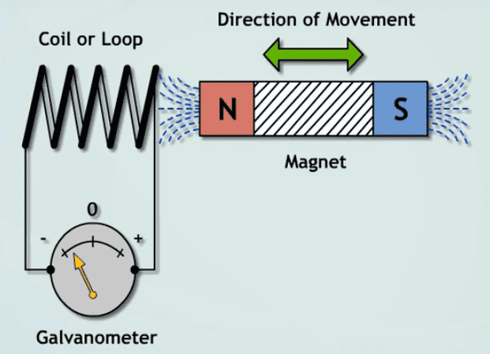
Faraday’s Law of Electromagnetic Induction
Faraday’s 1st law: Whenever a conductor is placed in a varying magnetic field, an electromotive force is induced. If the conductor circuit is closed, a current is induced which is called induced current.
Here are a few ways to change the magnetic field intensity in a closed loop:
By rotating the coil relative to the magnet.
By moving the coil into or out of the magnetic field.
By changing the area of a coil placed in the magnetic field.
Fig-1 Electromagnetic induction
https://www.electrical4u.net/wp-content/uploads/2018/06/Faradays-Law-of-electronagnetic-indution-6.png

Slide 8
Faraday’s Law of Electromagnetic Induction
Faraday’s 2nd Law:The induced emf in a coil is equal to the rate of change of flux linkage.
The flux is the product of the number of turns in the coil and the flux associated with the coil. The formula of Faraday’s law is given below:
Therefore,
E=Ndϕ/dt
Considering Lenz’s law,
E=−Ndϕ/dt
Fig-2 Electromagnetic induction
https://www.electrical4u.net/wp-content/uploads/2018/06/Faradays-Law-of-electronagnetic-indution-6.png
Notes:
Same as fig -3

Slide 9
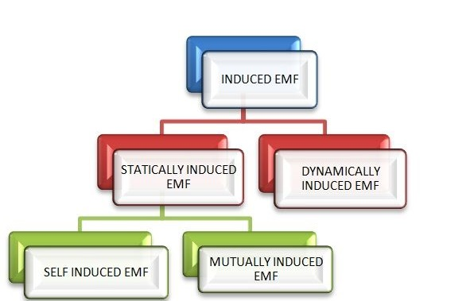
Classification of Induced EMF
Table-1 Classification of induced EMF
https://circuitglobe.com/wp-content/uploads/2015/08/indufced-emf.jpg
Notes:
Fig-5

Slide 10
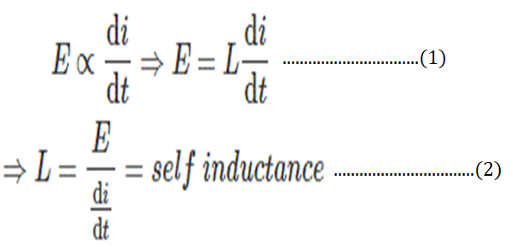
Self Induced EMF
Consider a coil having N number of turns as shown in the figure. When the switch S is closed & current I flows through the coil, it produces flux (φ) linking with its own turns.
If the current flowing through the coil is changed by changing the value of resistance (R), the flux linking with it, changes and hence emf is induced in the coil.

Slide 11
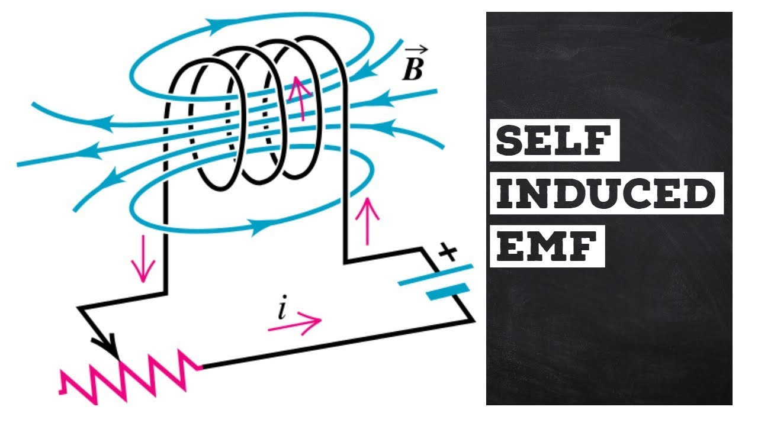
Self Induced EMF
This induced emf is called Self Induced emf. The direction of this induced emf opposes the change of current in the coil. This effect is because of Lenz’s Law.
The magnitude of self-induced emf is directly proportional to the rate of change of current in the coil. L is constant of proportionality and called as Self Inductance.
Fig-3 Self induced EMF
https://images.app.goo.gl/zREgsGt6emmhV83GA

Slide 12
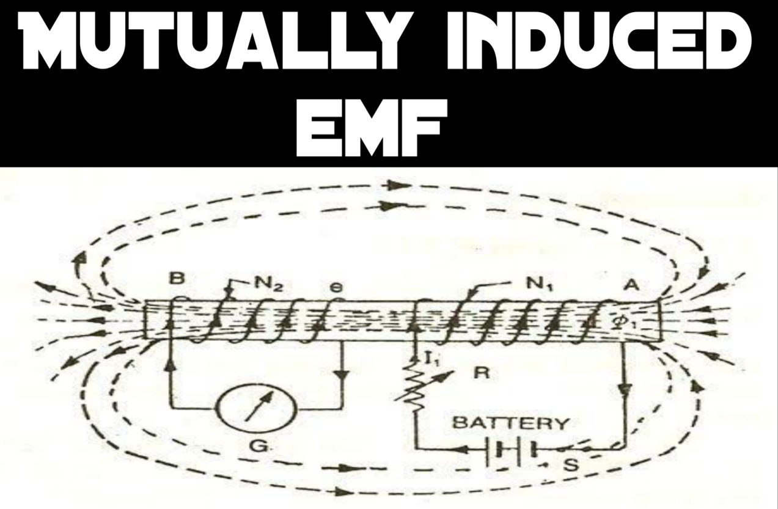
Mutual Induced EMF
The emf induced in a coil due to the change of flux produced by another neighbouring coil linking to it, is called Mutually Induced emf.
When the switch (S) is closed in the circuit shown above, current I₁ flows through the coil A, and it produces the fluxφ₁. Most of the flux says φ₁₂ links with the other coil B.
Fig-4 Mutually induced EMF
https://www.quora.com/What-is-the-difference-between-a-self-induced-EMF-and-a-mutually-induced-EMF

Slide 13
Mutual Induced EMF
If the current flowing through the coil A is changed by changing the value of variable resistor R, it changes flux linking with the other coil B and hence emf is induced in the coil.
This induced emf is called Mutually Induced emf.
Same as Fig-4 Mutually induced EMF
https://www.quora.com/What-is-the-difference-between-a-self-induced-EMF-and-a-mutually-induced-EMF

Slide 14
Single Phase Transformer
The transformer is the static device which works on the principle of electromagnetic induction.
It is used for transferring the electrical power from one circuit to another without any variation in their frequency.
In electromagnetic induction, the transfer of energy from one circuit to another takes places by the help of the mutual induction. i.e the flux induced in the primary winding is linked with the secondary winding.

Slide 15
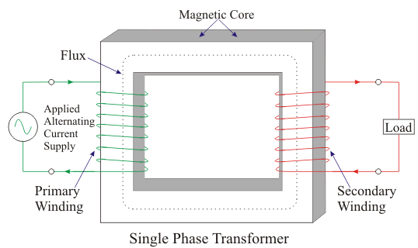
Working Principle of Single Phase Transformer
Working principle of electrical power transformer is similar to that of mutual induction.
A transformer is a static (or stationary) piece of apparatus by means of which electric power in one circuit is transformed into electric power of the same frequency in another circuit.
It can raise or lower the voltage in a circuit but with a corresponding decrease or increase in current.
Fig-5 Single phase Transformer
https://images.app.goo.gl/7ybQWzfTwcuKTP4PA

Slide 16
Working Principle of Single Phase Transformer
The physical basis of a power transformer is mutual induction between two circuits linked by a common magnetic flux.
In its simplest form, it consists of two inductive coils which are electrically separated but magnetically linked through a path of low reluctance.
Same as Fig-5 Single phase Transformer
https://images.app.goo.gl/7ybQWzfTwcuKTP4PA

Slide 17
Working Principle of Single Phase Transformer
The two coils possess high mutual inductance. If one coil is connected to a source of alternating voltage, an alternating flux is set up in the laminated core, most of which is linked with the other coil in which it produces mutually-induced e.m.f. (according to Faraday’s Law of Electromagnetic Induction e = M.dI/dt).
If the second coil circuit is closed, a current flow in it and so electric energy is transferred (entirely magnetically) from the first coil to the second coil.
The first coil, in which electric energy is fed from the a.c. supply mains is called primary winding and the other from which energy is drawn out, is called secondary winding.

Slide 18
Different types of a transformer
There are two types of a transformer
Step –up
Step-down

Slide 19
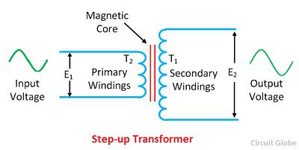
Step-up Transformer
A transformer in which the output (secondary) voltage is greater than its input (primary) voltage is called a step-up transformer.
The E₁ and E₂ are the voltages, and T₁ and T₂ are the number of turns on the primary and secondary winding of the transformer
The number of turns on the secondary of the transformer is greater than that of the primary, i.e., T₂ > T₁.
Fig-6 Step up transformer
https://circuitglobe.com/wp-content/uploads/2016/11/step-down-transformer.jpg

Slide 20
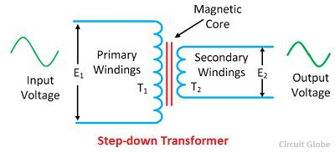
Step down transformer
A transformer in which the output (secondary) voltage is less than its input (primary) voltage is called a step-down transformer.
The number of turns on the primary of the transformer is greater than the turn on the secondary of the transformer, i.e., T₂ < T₁. The step-down transformer is shown in the figure below.
The voltage turn ratio of the step-down transformer is 2:1.
Fig-7 Step down Transformer
https://circuitglobe.com/wp-content/uploads/2016/11/step-up-transformer.jpg

Slide 21
Construction of Transformer
The transformers are of two general types, distinguished from each other merely by the manner in which the primary and secondary coils are placed around the laminated core.
The two types are known as
(i) core-type transformer (ii) shell-type transformer

Slide 22
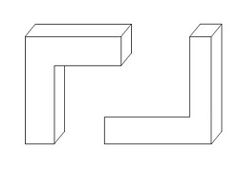
Core Type Transformer
The magnetic core of the transformer is made up of laminations to form a rectangular frame. The laminations are cut in the form of L-shape strips shown in the figure below.
For avoiding the high reluctance at the joints where laminations are butted against each other, the alternate layer is stacked differently to eliminate continues joints.
Fig-8 core type Core
https://circuitglobe.com/wp-content/uploads/2017/01/shell-type-transformer-circuit.jpg

Slide 23
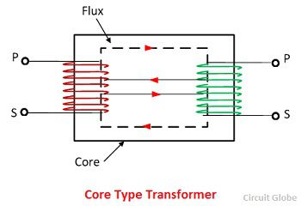
Core type transformer
The primary and secondary windings are interleaved to reduce the leakage flux.
Half of each winding is placed side by side or concentrically on the leg of the core as shown in the figure below.
For simplicity, the primary and secondary winding is located on the separate limbs of the core.
Fig-9 Core type Transformer
https://circuitglobe.com/wp-content/uploads/2017/01/shell-type-transformer-circuit.jpg

Slide 24
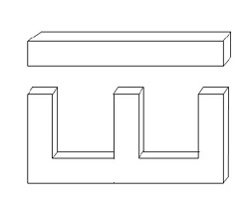
Shell Type Transformer
The laminations are cut in the form of a long strip of E’s, and I’s as shown in the figure.
To reduce the high reluctance at the joints where the lamination are butted against each other, the alternate layers are stacked differently to eliminate continuous joint.
The shell type transformer has three limbs or legs. The central limb carries the whole of the flux, and the side limb carries the half of the flux. Hence the width of the central limb is about to double to that of the outer limbs.
Fig-10 Shell type Core
https://circuitglobe.com/wp-content/uploads/2017/01/shell-type-transformer-circuit.jpg

Slide 25
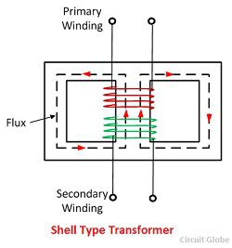
Shell Type Transformer
The primary and secondary both the windings are placed on the central limbs.
The low voltage winding is placed near the core, and the high voltage winding is placed outside the low voltage winding to reducing the cost of insulation placed between the core and the low voltage winding.
The windings are cylindrical, and the core laminations are inserted on it.
Fig-11 Shell Type Transformer
https://circuitglobe.com/wp-content/uploads/2017/01/shell-type-transformer-circuit.jpg

Slide 26
Transformation Ratio
The transformer transformation ratio or transformer turns ratio (K) is the quotient value obtained by dividing the number of turns of the primary winding (N1) and the number of turns of the secondary winding (N2).
Then
K = N1/N2
Further we may write
K = N1/N2 = V1/V2 = I2/I1

Slide 27
Applications of Single-phase transformer
The applications of a single-phase transformer are mentioned below.
To step-down long-distance signals to support both residential and light-
commercial electronic devices.
In television sets for voltage regulation.
To step-up power in home inverters.
To supply power to non-urban areas.
To isolate two circuits electrically as primary and secondary are placed far
from each other.

Slide 28
Frequently Asked Questions
1.) What does a single-phase mean?
Answer:- A single-phase system or circuit which generates or uses single alternating voltage.
2.) Do houses use single-phase supply?
Answer:- Generally, homes are supplied with single-phase supply.
3.) On which principles does the single-phase transformer operate?
Answer:- Faraday’s law of Electromagnetic Induction and Mutual Induction.

Slide 29
Frequently Asked Questions
4.) What is the transformer “Turns Ratio”?
Answer:- N1/N2 = V1/V2 = K = Turns Ratio
5.) Give two uses of a single-phase transformer
Answer:-
In television sets for voltage regulation
To step-up power in home inverters

Slide 30
Summary
Through this PPT , the students have learned and understood
Terminology of magnetic circuits.
Concept of self and mutual induction.
Principle of operation of transformers.
Construction of transformers
Performance analysis of transformers

Slide 31
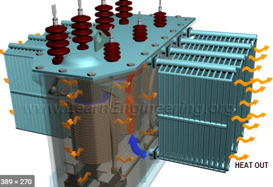
Learning Outcomes
To make students understand the
Terminology of magnetic circuits.
Concept of self and mutual induction.
Principle of operation of transformers.
Construction of transformers
Performance analysis of transformer
https://www.google.com/search?q=transformer+working+and+construction&source=lnms&tbm=isch&sa=X&ved=2ahUKEwjf7q2zo5XqAhXbb30KHcZ1A-MQ_AUoAnoECBEQBA&biw=1366&bih=608#imgrc=Hz4hgKww9splRM&imgdii=-GHifX4ZDm1raM
Fig-16

Slide 32
Course Outcome to Program Outcome Relationship
 |  | (21ELH-101) BEEE
PO→
CO↓ | PO1 | PO2 | PO3 | PO4 | PO5 | PO6 | PO7 | PO8 | PO9 | PO10 | PO11 | PO12 | PSO1 | PSO2 | PSO3
CO1 | 3 | 2 |  |  |  |  |  |  |  |  |  |  | 3
CO2 | 3 | 2 |  |  |  |  |  |  |  |  |  |  | 3
CO3 | 3 | 2 |  |  |  |  |  |  |  |  |  |  | 3
CO4 | 3 | 2 |  |  |  |  |  |  |  |  |  |  | 3
CO5 | 3 | 2 |  |  |  |  |  |  |  |  |  |  | 3

Slide 33
Assessment Pattern
A Assignment (each assignment) | B Time Bound Surprise Test (each test) | C Quiz (each quiz) | D Mid Semester Test(one per test) | E Homework | F Discussion Forums | G Attendance and engagement Score on BB
10 | 12 | 4 | 20 | NA | NA | 2

Slide 34
References
https://iopscience.iop.org/book/978-0-7503-2084-9/chapter/bk978-0-7503-2084-9ch1
https://circuitglobe.com/what-is-a-transformer.html
https://cnx.org/contents/FOAgj46E@1.1:CF55C3SF@1/chapter-1-Magnetic-Circuits-and-Magnetic-Materials
https://www.electronics-tutorials.ws/transformer/transformer-basics.html

Slide 35
THANK YOU
For queries
Email:akhilnigam.eee@cumail.in

